Slide 1

Behind the White Paper
Chinese
Youth
East Asia Resource Center, UW
Tese Wintz Neighbor 3/2023
tneighbor@aol.com
Notes:
Many of these quotes are excerpted from China’s Youth: Increasing Diversity Amid Persistent Inequality by Li Chunling.

Slide 2
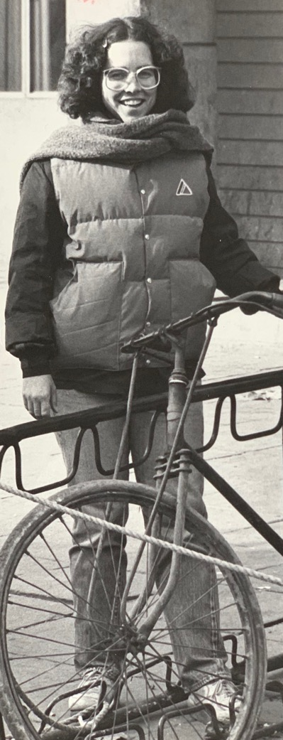
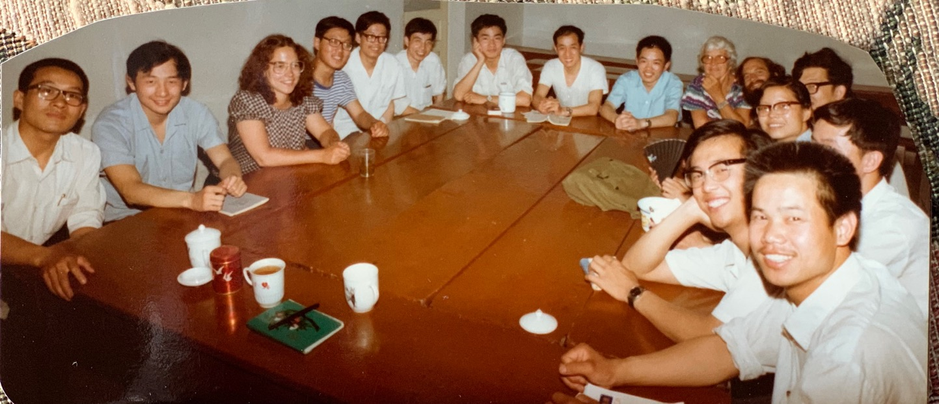
What was I thinking?
And how do I define ”youth?”
Very broadly!
Roughly born in 1989 to 2010 (16-32 year olds)
Let’s just say “Young China.”
Notes:
When I was a youth in 1982, I taught at Beijing University. Even thought I am now past middle age, my studies and interest continue to focus on Chinese youth!

Slide 3
Young China
Will this Generation Change China and the World?
There are more young people in China than there are in North America, Europe, and the Middle East combined – more than the combined populations of the US and Canada.
To the direction of the country, we need understand Young China: who they are, what they want, and how they see the world.

Slide 4
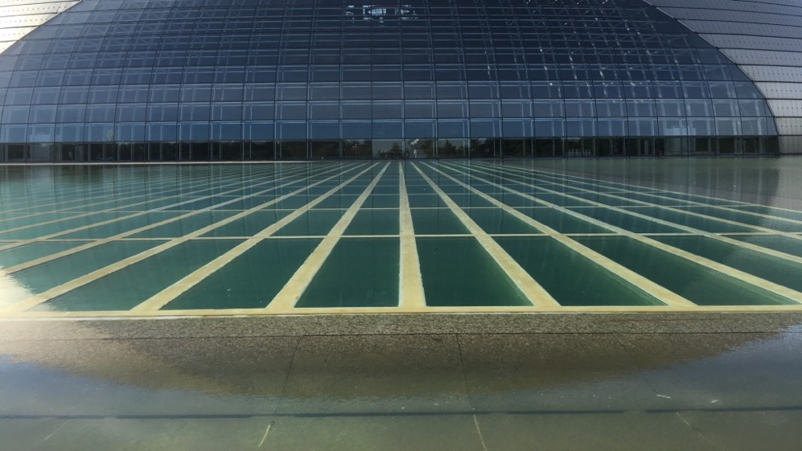
What factors have shaped China’s Millennial Generation? And are continuing to shape her younger generations?
Today’s youth are a product of
1. CHINA’S ECONOMIC MIRACLE & AFFLUENT SOCIETY RESULTING FROM DENG XIAOPING’S REFORM & OPENING
China’s “reform and open-door” policy began in 1978.
It introduced private business and market incentives to what was a state-led communist system.
Today private firms contribute to approximately 70% of China’s GDP.
800 million lifted out of poverty (World Bank, 2022)
50% now in “middle income group” (Pew Research Center, 2018)
GDP has grown 60 times larger; per capital income 25 x higher since “reform and opening.”
Notes:
https://www.worldbank.org/en/news/press-release/2022/04/01/lifting-800-million-people-out-of-poverty-new-report-looks-at-lessons-from-china-s-experience
https://research.nus.edu.sg/eai/wp-content/uploads/sites/2/2021/09/EAIC-33-20210903.pdf
Li Chunling’s China’s Youth
https://pseudoerasmus.files.wordpress.com/2015/02/yao-chinese-growth-miracle-handbook2.pdf
https://www.businessinsider.com/china-middle-class-starting-to-look-like-americas-2021-12
https://chinapower.csis.org/china-middle-class/

Slide 5
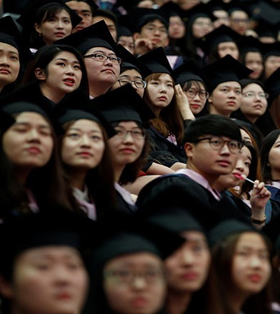
Today’s youth are a product of
2. THE LARGEST EXPANSION OF HIGHER EDUCATION IN CHINESE HISTORY
Percentage to attain higher education Post ‘50s – 3%
Post ‘60s – 4 %
Post ‘70s – 11%
Post ‘80s – 23%
Post ‘90s – 40%
Notes:
Li Chunling’s China’s Youth, P. 21

Slide 6
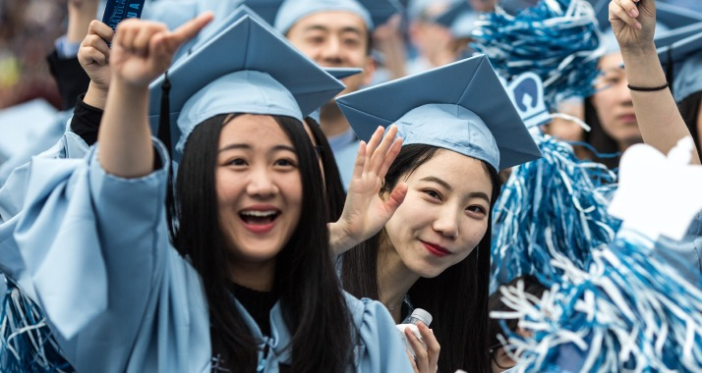
Today 58% are enrolled in colleges & trade schools
The pathways to gaining admission to good universities are still limited.
The national exam “gaokao” remains the only way to enter a good public university.
Some students study abroad to avoid the national exam and to gain admission to a better ranked university.
With more educated youth and fierce competition in the labor market has led to employment pressure for graduates from rural areas and graduates of 2nd & 3rd tier colleges.
Notes:
https://data.worldbank.org/indicator/SE.TER.ENRR?locations=CN
https://www.statista.com/statistics/227240/number-of-chinese-students-that-study-abroad/
703,500 students studied abroad in 2019, the largest country of origin for international students in the world
Almost 82,000 Chinese were enrolled in US high school students in 2016 (lower now due to more international schools in China, economic woes, and Covid-19).
https://files.eric.ed.gov/fulltext/EJ1330222.pdf

Slide 7
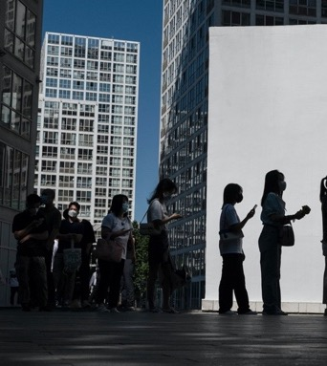
IN THE NEWS:
ONE OUT FIVE URBAN YOUTH UNEMPLOYED
The 19 percent. Economy battered by 3 years of the pandemic, top cities are emerging from months-long lockdowns, govt crackdown on large tech, and the explosion of college grads.
The 19 percent. Make up of INDIVIDUAL MILLIONS and millions of broken dreams, millions questioning what constitutes a good life, millions of anxieties.
tang ping 躺平 “lying flat”
rejecting grueling work culture (9-9-6)
bai lan 摆烂 “let it rot”
retreat from goals
nèijuǎn 内卷 “involution”
An adequate life is unattainable/unsustainable
kenlauzu 啃老族 “feed off their parents”
Notes:
https://blogs.worldbank.org/peoplemove/chinas-hukou-reform-remains-major-challenge-domestic-migrants-cities
https://www.paulsoninstitute.org/archives/five-things-to-know-about-chinas-floating-population/
Podcast: https://www.imiscoe.org/news-and-blog/podcast/1103-xinyuan-wang-about-the-floating-population-in-china

Slide 8
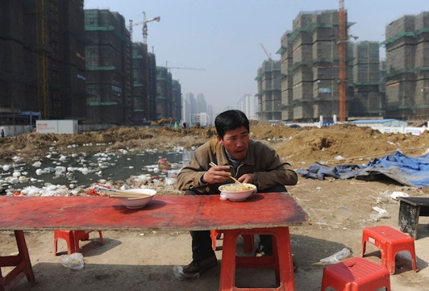
Today’s youth are a product of
With Deng’s reforms, the “floating population” (liudong renkou) grew from 6.57 million migrants in 1982 to 376 million in late 2020.
One in six people are on the move – 2/3 of them under the age of 35.
Millennial rural-urban migrants are better educated, more sensitive to job discrimination, more protective of their rights.
The “floating population” is no longer “floating.”
3. LARGEST INTERNAL MIGRATION IN CONTEMPORARY CHINA
Notes:
https://blogs.worldbank.org/peoplemove/chinas-hukou-reform-remains-major-challenge-domestic-migrants-cities
https://www.paulsoninstitute.org/archives/five-things-to-know-about-chinas-floating-population/
Li Chunling’s China’s Youth
Podcast: https://www.imiscoe.org/news-and-blog/podcast/1103-xinyuan-wang-about-the-floating-population-in-china

Slide 9
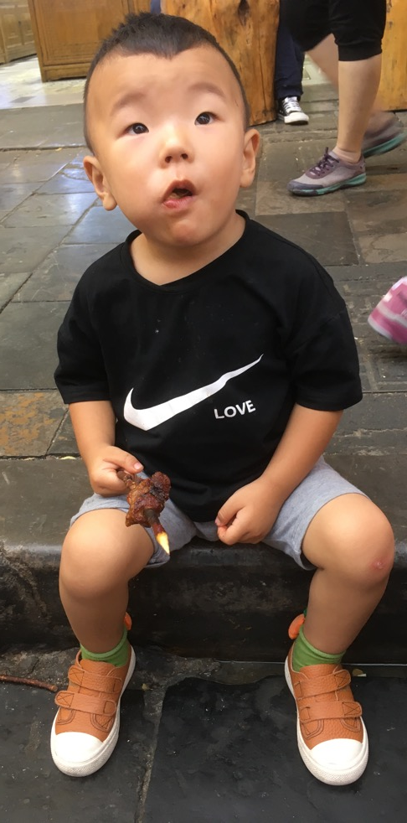
Today’s youth
are a product of
4. THE IMPACT OF THE ONE-CHILD POLICY
China’s one-child policy began in 1980.
It led to sex-selective abortions or infanticide targeting girls, because of a centuries-old social preference for boys.
Family miniaturization and declining birthrates has changed the intergenerational relationship and the manner of raising children.
Are Chinese youth the most spoiled generation in Chinese history?
These “little emperors” are the center of the 4-2-1 family structure with care and attention from two parents and four grandparents.
Deemed to be “timorous, caution, phobic, antisocial, willful, childish, selfish, jealous, bad-tempered, stubborn, highly unstable, undersocialized, underdeveloped and lack in quality and moral fiber.’
Notes:
It restricted most couples to only a single offspring, and for years authorities argued it was a key factor in supporting the country’s economic boom.
China’s latest census confirmed Chinese mothers gave birth to just 12 million babies in 2020, down from 14.65 million in 2019.
Li Chunling’s China’s Youth
What was China’s one-child policy?
China’s one-child policy was rolled out in 1980 by Deng Xiaoping and was strictly enforced after the population had increased to 969 million in 1980 from around 540 million in 1949.
It restricted most couples to only a single offspring, and for years authorities argued it was a key factor in supporting the country’s economic boom.
It was enforced by the National Health and Family Planning Commission, with a system of fines for violators and often forced abortions. If parents did not pay a fine, second children could not be registered in the national household system, meaning they did not exist legally and so would not have access to social services like health care and education. Rural families were already allowed two children if the first was a girl, while ethnic minorities were allowed an extra offspring, leading some to dub it a “one-and-a-half child” policy. Urban couples were also allowed to have a second child if the parents were both single children. https://www.scmp.com/economy/china-economy/article/3135510/chinas-one-child-policy-what-was-it-and-what-impact-did-it

Slide 10
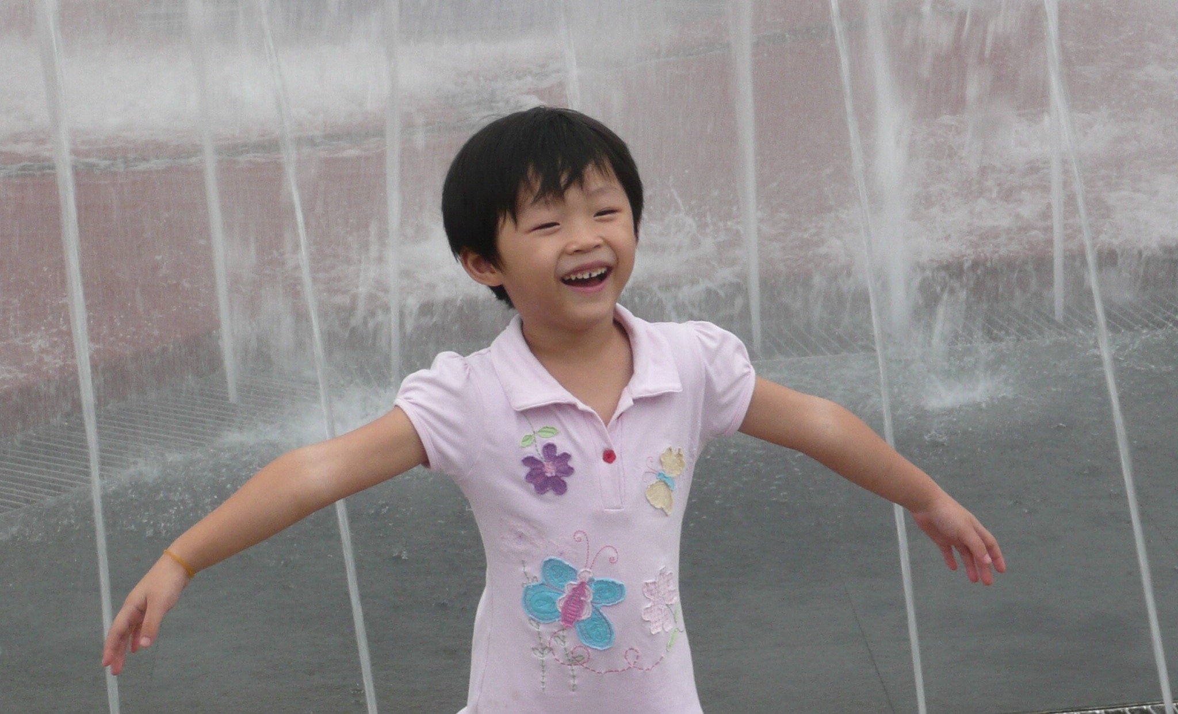
But wait! Other Chinese scholars disagree.
Some believe that parents and only children have become more intimate and equal and that only children are more respected in terms of their personality and sense of autonomy.
The impact of the one-child phenomenon does not only affect the physical and psychological quality of the new generation of individuals, it also penetrates all aspects of society at both individual and family levels.
As the new generation enters society, its beliefs and behaviors of self-confidence, autonomy, and openness are also changing the intergeneration relationship of Chinese society as a whole.
Young are no longer “just passive and obedient” and the older generation are no longer seen as “educators with absolute authority.”
Notes:
Li Chunling’s China’s Youth

Slide 11

Today’s Youth are a product of
5. THE ARRIVAL OF THE INTERNET & SOCIAL MEDIA
The Internet has transformed the lives of all generations in China. But it has become “enmeshed within every aspect of young people’s lives.”
More than 90% have smart phones and virtually 100% of young urban professionals use WeChat (weixin).
Digital youth have fundamentally changed the SOCIAL STRUCTURE, SOCIAL SPACE, and SOCIAL CONNECTION within Chinese society.
Notes:
Li Chunling’s China’s Youth

Slide 12
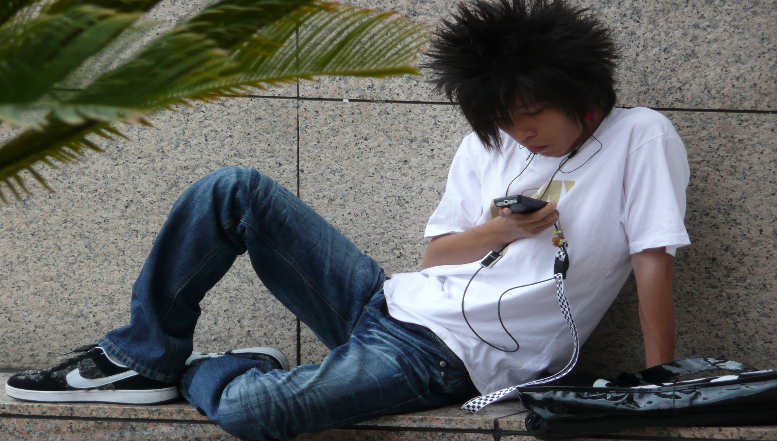
SOCIAL STRUCTURE
The older generation was always the gatekeepers of family and society. Now the youth through the internet are the driving force for social transformation.
SOCIAL SPACE
Before two public opinion fields: OFFICIAL PUBLIC (ubiquitous official media) and PRIVATE PUBLIC (squares, parks, auditoriums).
Now heated internet discussions can shape opinion and even trigger incidents to challenge authorities. Some are magnified (white colored workers demanding clean air in first-tier cities) while others neglected (blue-color workers demanding jobs in 3rd & 4th-tier cities). The former group largely controls the virtual space (so outsized influence on policy priorities).
SOCIAL CONNECTION
Reduced distance between people/enlarged social circles. (Blued – largest gay network in the world. Coming out on line – brought together a minority community without activism. Launched in China in 2012, 40 M worldwide.)
Notes:
https://www.nytimes.com/2020/03/05/magazine/blued-china-gay-dating-app.html
https://restofworld.org/2021/china-bluecity-healthcare-dating-apps/
Li Chunling’s China’s Youth

Slide 13
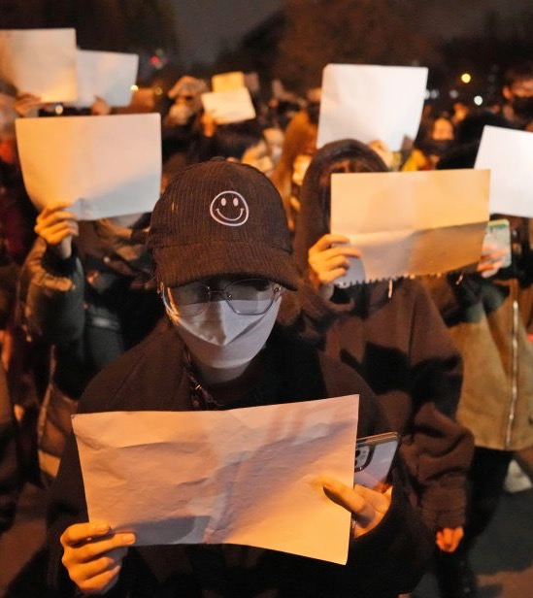
In The News
“The White Paper” Protests
Metaphor for the critical social media posts, news articles, and outspoken online accounts that WERE WIPED FROM THE INTERNET as thousands of people took to the streets.

Slide 14
“The growing diversity among young both in terms of comparisons with previous generations and among millennials themselves is evident in virtually all domains — from consumption, lifestyle, and attitude about sex and marriage to social tolerance, political behavior, national identity, and world view.”
They share the sense that the older generation has saddled them with enormous issues.
Younger Chinese generations differ in interesting ways from their predecessors, as well as their foreign counterparts.
In what ways are they similar to their parents? To US youth?
Chinese and US youth shaped by their parents and physical/political/social environment.
Some say “these days generations change every 5 years.” Would you?

Slide 15
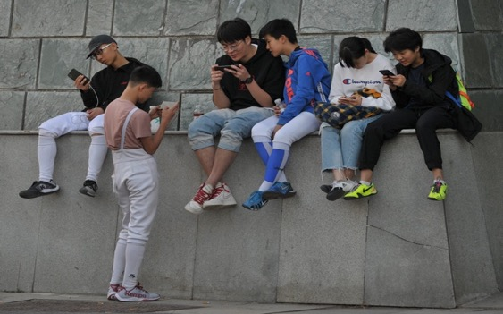
Go Team!
Overall Chinese youth no longer see themselves as creatures of a country’s past, but as creators of its future.
“…Like America, China’s future is undoubtedly in the hands of its young people. And as China’s future will be inextricably connected to our own, it is essential for us to develop a comprehensive and accurate understanding of this generation…”
Notes:
Li Chunling’s China’s Youth

Slide 16
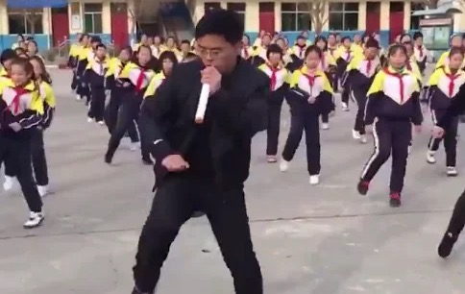
Crank up your sound!
School Principal Leads Students in Dancing
to a New Beat
Notes:
https://www.npr.org/687749466
https://www.npr.org/2019/01/23/687749466/watch-in-china-school-principal-leads-students-in-dancing-to-a-new-beat

