Slide 1

JSIS Strategic Plan Update
August 16th Staff Meeting

Slide 2
Norms and expectations (7/20 Staff meeting)
Our EDIA mission will be our throughline and constant focus
  Diversity and Equity Committee - The Henry M. Jackson School of International Studies (washington.edu)
Listen to learn and explore
Assume good intentions, ask for clarity when needed
Creating an environment that supports professional candor and direct communication
Create opportunities for your colleagues to engage and share
Come prepared and ready to meetings, provide completed deliverables on time
We appreciate that change is hard but necessary (especially for JSIS)

Slide 3

Resources
Simple - Sustainable - Integrated
Start with Worksheet Rollout (Lacey)
Unit Input (Staff and Faculty)
Stakeholder Engagement (Outreach to Internal or External)
Workshopping Documents (Steering Committee)
Finalized Consolidated JSIS Document (Steering Committee)
Finalized Unit Worksheet and share w/Lacey (Unit Leadership POC)
Report out and inclusion in plan documentation (Lacey)
Worksheets for gathering information
#1 Values Worksheet
#2 Environmental Analysis Worksheet
#3 Strengths, Weakness, Opportunities and Threats, SWOT Worksheet
AND Templates for working documents
#4 Risk Assessment
#5 Action Plans (inform Performance Management Workplans)
#6 Snapshots (inform Impact/ Year End reports)
* Unit = Center, Program, or Operational Group

Slide 4
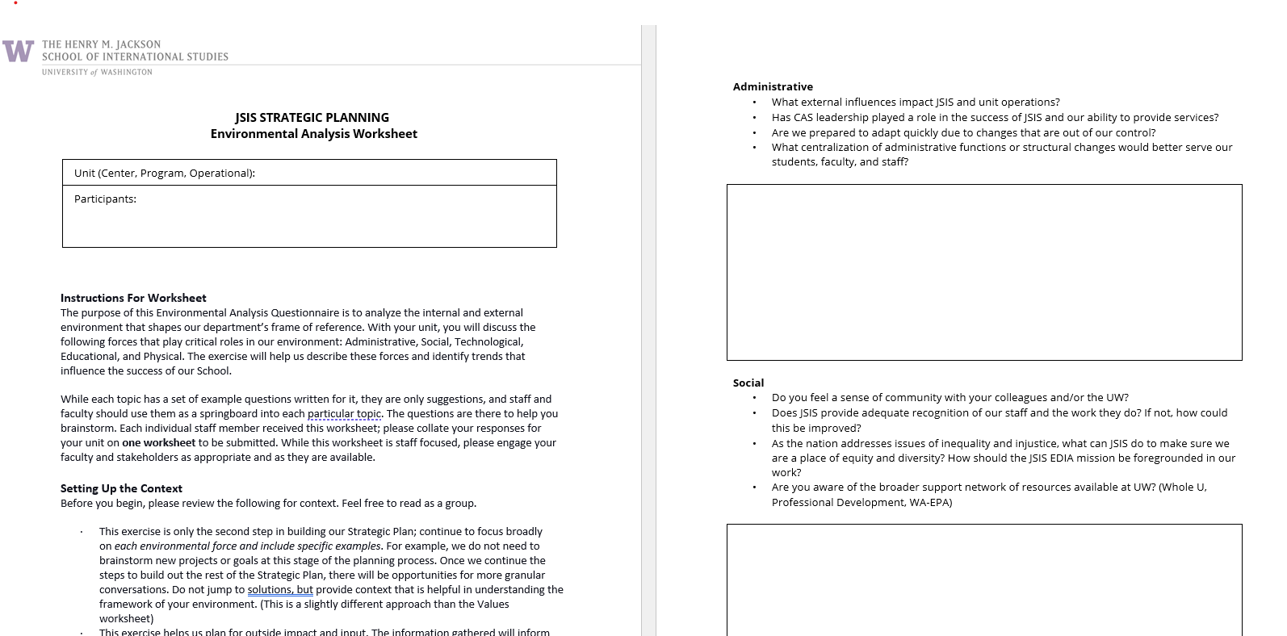
Environmental Analysis Worksheet
Five main factors- Administrative, Educational, Social, Educational and Physical
An opportunity to think about factors beyond our control and how they may impact our work.
Not ready for solutions, but context or examples are helpful (this is slightly different from the Values worksheet)

Slide 5
Timeline
Our timeline is changing…
Time to celebrate
* Unit = Center, Program, or Operational Group
AUT Quarter
February 2024
Strategic planning process rollout (Training)
Lacey
Complete Values, Environmental analysis, SWOT Worksheets (Doing)
Units
Focus, goals, strategies (Planning)
Steering Committee
Strategy road map rollout (Training) Update on plan and progress
Lacey
Communicate, risk assessment, solidify action plans (Doing)
Units
Monitor using templates, communicate snapshots, update plans (Doing- ongoing)
All
All School Meeting
August and September 2023
September 2023
July 2023
Faculty Retreat-
Visioning exercise with Curriculum and Research support focus

