Slide 1
Unit 1: South Asia as region
India and south Asia: From area studies to ethnic studies
Developed by Rachel Heilman (Issaquah High School) with support from the South Asia Center at the University of Washington with funding from the U.S. Department of Education National Resource Centers Program.
Cultural Diffusion

Slide 2

First, let’s get the vocabulary we need for our discussion!
Be prepared to take some notes.

Slide 3
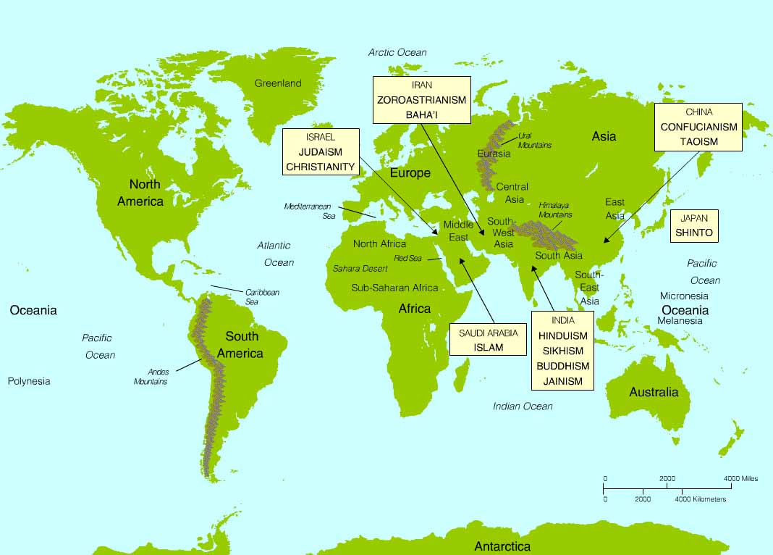
Cultural hearth
  Geographic place of origin for a cultural feature (like a belief system)
Source: “Geopolitical Regions of the World and the Birthplaces of Twelve Major Living Religions” from Patterns of Religion http://s-wadsworth.cengage.com/religion_d/special_features/popups/maps/index.html

Slide 4
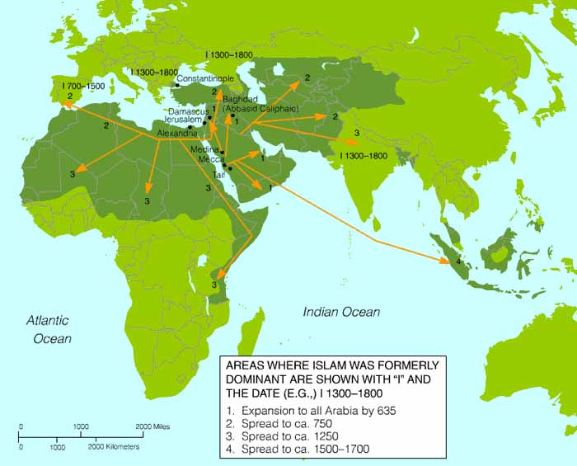
Cultural Diffusion
The spread of ideas, behavioral patterns, and technology out from the place they originated
Source: “Dispersion of Islam Through 1800 C.E.” from Patterns of Religion http://s-wadsworth.cengage.com/religion_d/special_features/popups/maps/index.html

Slide 5
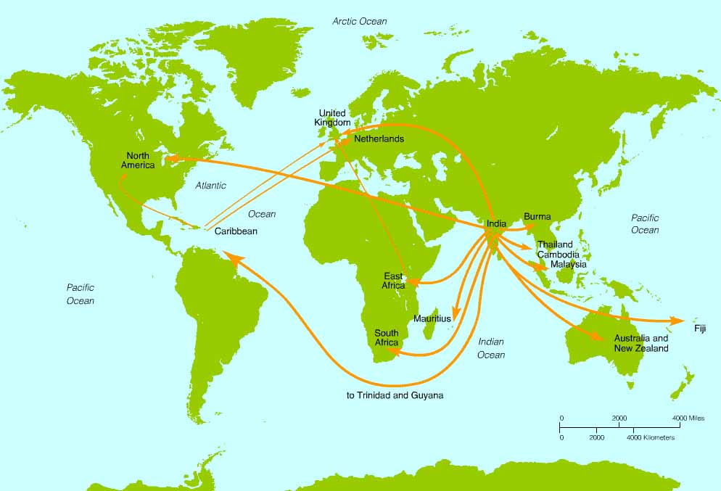
Ethnic religion
  Closely tied to a particular cultural hearth and ethnic group (spreads through migration of practitioners)
Source: “World Dispersion of the Hindu Community” from Patterns of Religion http://s-wadsworth.cengage.com/religion_d/special_features/popups/maps/index.html

Slide 6
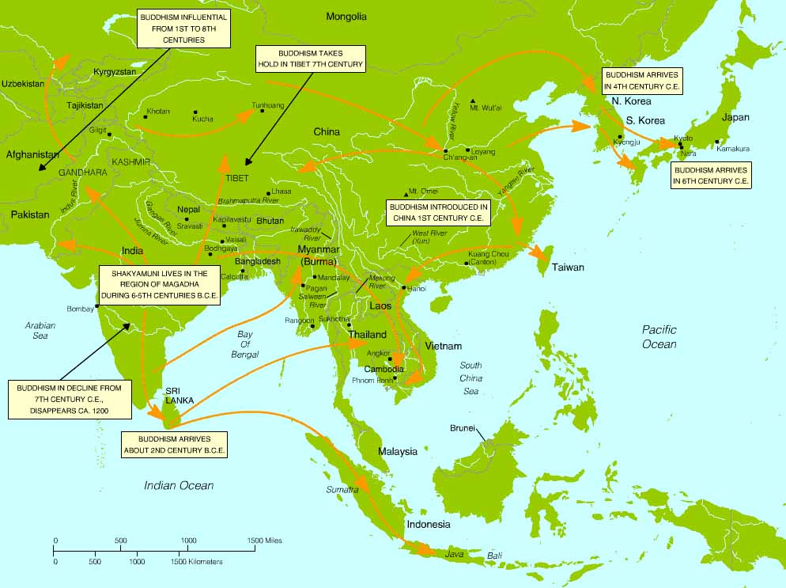
Universalizing Religion
Meant to appeal to members of all ethnic groups and people in diverse geographic locations (spread through migration, but also through missionaries/conversion)
Source: “Shakyamuni’s Birthplace and Dispersion of Buddhism to East Asia” from World Religions http://s-wadsworth.cengage.com/religion_d/special_features/popups/maps/index.html

Slide 7
Now, let’s use that new vocab to draw some conclusions about the role belief systems can play in helping us conceptualize South Asia as a region.
Be ready to record your thoughts in your notes!

Slide 8
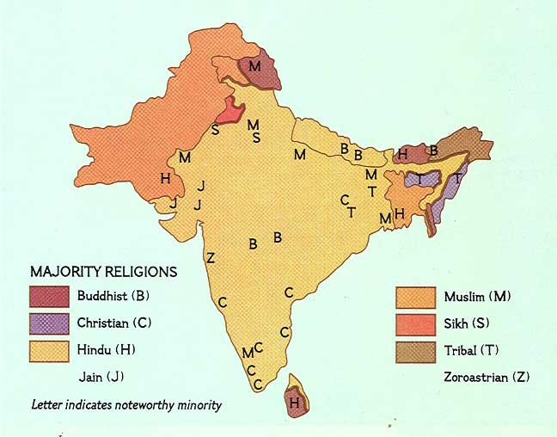
Remember the map you made in the last lesson depicting the distribution of religions in South Asia? You should have that available to act as a reference as we work through the prompts on the following slides.
Source: “Religions of South Asia” from National Geographic (1984) http://www.columbia.edu/itc/mealac/pritchett/00maplinks/overview/religions/religions.html

Slide 9
Cultural Diffusion
As of 2019, the only country in the world with more Muslims than India is Indonesia. India is followed by Pakistan and Bangladesh. There are a lot of Muslims in South Asia!
Should the fact that Islam did not originate in South Asia impact how we can use it to delineate the region’s boundaries?
Source: “Dispersion of Islam Through 1800 C.E.” from Patterns of Religion http://s-wadsworth.cengage.com/religion_d/special_features/popups/maps/index.html

Slide 10
Ethnic religion
  Hinduism is closely tied to India, but the boundaries of modern India were drawn quite recently (1947) and there are many Hindus living outside of the region.
  Does that impact the way we can use Hinduism to delineate South Asia’s boundaries?
Source: “World Dispersion of the Hindu Community” from Patterns of Religion http://s-wadsworth.cengage.com/religion_d/special_features/popups/maps/index.html

Slide 11
Universalizing Religion
Buddhism originated in South Asia, but most of its practitioners today live outside of the region.
How does that complicate our attempts to use belief systems to delineate South Asia’s regional boundaries?
Source: “Shakyamuni’s Birthplace and Dispersion of Buddhism to East Asia” from World Religions http://s-wadsworth.cengage.com/religion_d/special_features/popups/maps/index.html

Slide 12
To wrap things up, finish this sentence:
It can be a challenge to use belief systems as we attempt to define South Asia’s regional boundaries, but/so __________________.

