Slide 1
One Semester Elective (11th & 12th Graders)
India & South Asia:
From Area Studies to Ethnic Studies

Slide 2
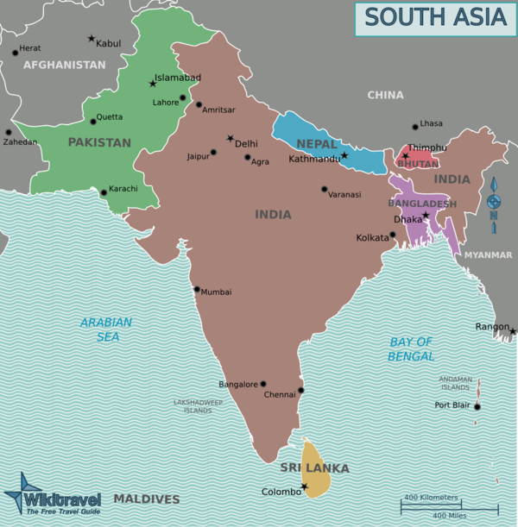
Is this class for you?
Yes! Especially if…
You always wished you could learn about topics in Social Studies with much more depth and at a slower pace than you usually get to – you want a chance to truly think through things and understand them holistically
You’re interested in knowledge production – where do the “things we know” come from?
You’d like some interdisciplinary experience
You would like a class that challenges you academically, but does not require work or studying outside of class
You’ll enjoy a connection with UW’s scholarship, whether your career path will take you in that direction or not

Slide 3
India & South Asia: From Area Studies to Ethnic Studies
Description
How can understanding a particular region both shape and enhance our understanding of ourselves and the world around us? As we gain knowledge, how do we both recognize and cross the political boundaries we see on maps? In this one-semester course we will use an interdisciplinary approach to examine India and wider South Asia as we work to conceptualize the ways people, power, geography, and the past shape the region. For the purposes of this course South Asia will include Bangladesh, Bhutan, India, Maldives, Nepal, Pakistan, and Sri Lanka. In our role as global citizens we will also expand our inquiries to the web of connections between South Asia and our own individual and social identities.
Expectations and Goals
Units include:
South Asia as a Region
Identities in South Asia
Diffusion of People and Cultures
Student-Led Inquiry and Presentation
Throughout the course we will be gaining an understanding of interdisciplinary approaches to the construction of knowledge:
Area Studies
International Studies
Ethnic Studies

Slide 4
Questions?
Contact

